Slide 1
CSCI 1301 Introduction to Computing and Programming
Summer 2015

Slide 2
Practice (if statements)
Write an if-else statement that assigns 20 to the variable y if the variable x is 100 or larger. Otherwise, it should assign 0 to the variable y.
Write an if statement that prints “It contains ‘k’ “ if the String variable myString contains the letter ‘k’.

Slide 3
The Conditional Operator
There is a quick way to write short branching statements.
? and : together are called the conditional operator.
Instead of writing: if (n1 > n2)
max = n1;
else
max = n2;
One writes: max = (n1 > n2) ? n1 : n2;
Given (n1 > n2) ? n1 : n2
The Boolean expression is evaluated.
If true, the first value (the value of n1) is returned.
If false, the second value (the value of n2) is returned.

Slide 4
The Conditional Operator
The conditional operator can be used in other situations as well
It is useful with print and println statements.
int hours = 1;
System.out.print("You worked " + hours +
((hours > 1) ? "hours” : "hour"));
OR
int hours = 1;
String hourOrHours =(hours > 1)?“hours”:”hour”;
System.out.print("You worked " + hours + hoursOrHours);

Slide 5
Switch Statements

Slide 6
The switch Statement
Instead of a multi-branch if-else, one can use a switch statement.
int numberOfDogs;
…//Ask the user how many dogs they have
switch (numberOfDogs)
{
case 1:
System.out.println(“That’s nice!");
break;
case 2:
System.out.println("Buddies!");
break;
case 3:
System.out.println(“Three’s a crowd");
break;
default:
System.out.println(“Are you serious?!?");
break;
}

Slide 7
The switch Statement
It begins with the keyword switch followed by a controlling expression.
int numberOfDogs;
…
switch (numberOfDogs) // switch (the controlling expression)
{
case 1:
System.out.println(“That’s nice!");
break;
case 2:
System.out.println("Buddies!");
break;
case 3:
System.out.println(“Three’s a crowd");
break;
default:
System.out.println(“Are you serious?!?");
break;
}

Slide 8
The switch Statement
Braces enclose a set of cases.
Each case begins with case followed by a case label.
The case label is followed by a colon (:), then one or more statements.
If the value of the controlling expression matches the case label of a particular case, the statements for that case are executed.
int numberOfDogs;
…
switch (numberOfDogs) // switch (the controlling expression)
{
case 1:
System.out.println(“That’s nice!");
break;
case 2:
System.out.println("Buddies!");
break;
case 3:
System.out.println(“Three’s a crowd");
break;
default:
System.out.println(“Are you serious?!?");
break;
}

Slide 9
The switch Statement
An optional break statement prevents statements from later cases being executed.
Statements in the default case are executed if no other case is matched.
int numberOfDogs;
…
switch (numberOfDogs) // switch (the controlling expression)
{
case 1:
System.out.println(“That’s nice!");
break;
case 2:
System.out.println("Buddies!");
break;
case 3:
System.out.println(“Three’s a crowd");
break;
default:
System.out.println(“Are you serious?!?");
break;
}

Slide 10
The switch Statement
The case labels must be constants.
String literals are allowed.
Duplicate case labels are not allowed in a single switch statement.
The default case is optional, but recommended, even if it simply prints a message.

Slide 11
public static void main(String[] args)
{
int numberOfDogs;
System.out.print("Enter number of dogs you have: ");
Scanner keyboard = new Scanner(System.in);
numberOfDogs = keyboard.nextInt();
switch (numberOfDogs) // controlling expression
{
case 1: // case with case label 1
System.out.println(“Nice!");
break;
case 2: // case with case label 2
System.out.println(“Buddies!");
break;
case 3:
System.out.println(“Three’s a crowd!");
break;
case 4: // case with no break statement
case 5:
System.out.print(“Wait… ");
System.out.println(numberOfDogs + " dogs?!?");
break;
default: // optional default statement.
System.out.println("I don't believe you.");
break;
}
}

Slide 12
The switch Statement
switch (Controlling_Expression)
{
case Case_Label:
Statement(s);
break;
case Case_Label:
…
default:
…
}

Slide 13
The switch Statement
The controlling expression can be anything that evaluates to an integer value, a char, or a String.
char letterGrade = 'a';
switch (letterGrade) {
case 'A':
case 'a':
System.out.println("Grade A");
break;
case ‘B':
case ‘b':
System.out.println("Grade B");
break;
default:
System.out.println("Not A or B");

Slide 14
The switch Statement
The controlling expression can be a compound expression, provided it evaluates to an integer value, a char, or a String. No floating point values?
int key = 1;
switch (key+1)
{
case 1:
System.out.println("First");
break;
case 2:
System.out.println("Second");
break;
case 4:
System.out.println("Fourth");
case 3:
System.out.println("Third");
break;
default:
System.out.println("Other");
}

Slide 15
The switch Statement
The controlling expression can be a compound expression, provided it evaluates to an integer value, a char, or a String.
Before Java 7, Strings weren’t allowed.
String key2 = "hello red fish";
switch (key2.substring(6))
{
case "one fish":
System.out.println("First");
break;
case "two fish":
System.out.println("Second");
break;
case "red fish":
System.out.println("Third");
break;
case "blue fish":
System.out.println("Fourth");
break;
default:
System.out.println("Other");
}

Slide 16
Enumerations in Switch Statements
Often, values for a variable should only come from a fixed set of possible values.
An enumeration allows one to specify this.
Like named constants, enum declarations appear inside the class body but outside of any method definitions (outside of main).
Once defined, variables can be declared using the enumeration’s name as data type.
enum MovieRating {G, PG, PG13, R, NC17}
MovieRating jaws = MovieRating.PG;

Slide 17
enum MovieRating {G, PG, PG13, R, NC17}
MovieRating jaws = MovieRating.PG;
switch(jaws)
{
case G:
System.out.println("General Audiences");
break;
case PG:
System.out.println("Parental Guidance Suggested");
break;
case PG13:
System.out.println("Parents Strongly Cautioned");
break;
case R:
System.out.println("Restricted ");
break;
case NC17:
System.out.println("No One 17 and Under Admitted");
break;
default:
System.out.println("");
}

Slide 18
Summary Questions
Can we rewrite a multi-branch if-else statement as a nested if-else statement?
Can we use switch with a boolean variable?
When is it better to use an if-else statement than a switch statement?
When is it better to use a switch statement than an if else statement?
Can we get by with just using switch statements?
What is output by the below code?
String s = "" + (5 > 4);
System.out.println(s);

Slide 19
Precedence Rules
Parentheses should be used to indicate the order of operations.
When parentheses are omitted, the order of operation is determined by precedence rules.
Operations with higher precedence are performed before operations with lower precedence.
Operations with equal precedence are done left-to-right (except for unary operations which are done right-to-left).

Slide 20
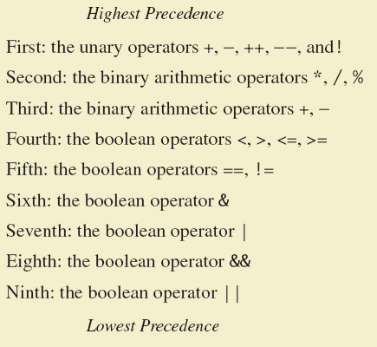
Precedence Rules

Slide 21
Precedence Rules
// In what order are the
// operations performed?
boolean b;
int score = 90;
int min = 10;
b=score < min/2 - 10 || score > 90;
b=score < (min/2) - 10 || score > 90;
b=score < ((min/2) - 10) || score > 90;
b=(score < ((min/2) - 10)) || score > 90;
b=(score < ((min/2) - 10)) || (score > 90);

Slide 22
Precedence Rules
// In each, what is the value of r?
boolean p = true;
boolean q = false;
boolean r;
r = p || !p;
r = !(p && !p);
r = !q && p;
r = !q && !!p;
r = p == true == true;
r = false || true == true;
r = true || false == true;
r = false || !false == true;
r = 5 > 6 == false && p;
r = 5 > 6-2;
r = false == true | true == false;
Can create more complex expressions…

Slide 23
The exit Method
Sometimes, continuing execution is pointless.
A program can be terminated normally by calling
System.exit(0).
if (numberOfWinners == 0)
{
System.out.println("Error: Dividing by zero.");
System.exit(0);
}
else
{
oneShare = payoff / numberOfWinners;
System.out.println("Each winner will receive $" + oneShare);
}

Slide 24
Flow of Control: Loops
Chapter 4

Slide 25
Java Loop Statements
A portion of a program that repeats a statement or a group of statements is called a loop.
The repeated statement or group is the body of the loop.
There must be some means of exiting a loop.
Otherwise, it repeats forever.
In Java, there are only a few types of loop statements.
The while statement
The do-while statement
The for statement

Slide 26
The while Statement
Also called a while loop
It repeats while a controlling boolean expression is true.
The body usually has a statement that eventually makes the controlling expression false.
while (Boolean_Expression)
Body_Statement
Or
while (Boolean_Expression)
{
First_Statement
Second_Statement
…
}

Slide 27
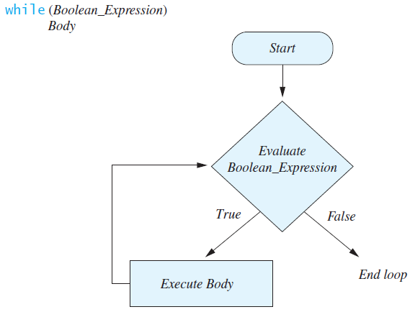
The while Statement
Graphically, this is how a while statement affects program execution.

Slide 28
import java.util.Scanner;
public class WhileDemo
{
public static void main(String[] args)
{
int count, number;
System.out.println("Enter a number");
Scanner keyboard = new Scanner(System.in);
number = keyboard.nextInt( );
count = 1;
while (count <= number)
{
System.out.print(count + ", ");
count++;
}
System.out.println( );
System.out.println("Yay! We can count!");
}
}
What if we input 0?

Slide 29
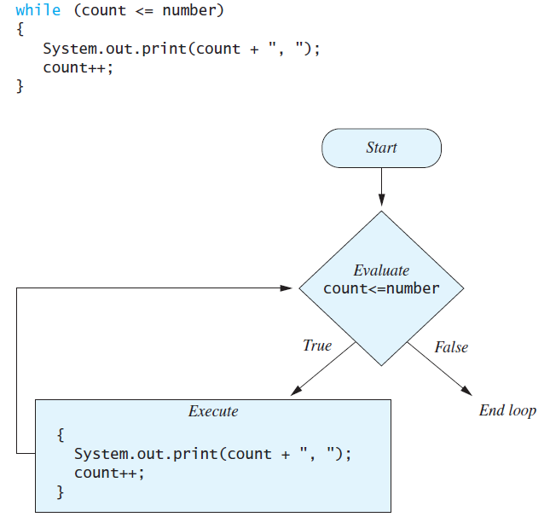
The while Statement

Slide 30
Practice #1
Write a program to read in three integers and determines the minimum value entered.
You may assume the three values are entered on a single line.
You may only use two int variables, min and temp.
Enter 3 integers.
Enter them all on one line.
> 9 2 3
Minimum is: 2

Slide 31
Practice #2
Now write a program to read in three integers and print them in order.
You may assume the values are entered on a single line.
You may use 4 int variables, min, middle, max, and temp.
Enter 3 integers.
Enter them all on one line.
> 42 7 30
7 30 42

Slide 32
Practice #3
Write a program which prompts the user to enter a day of the week, and then prints out the meal served that day.
If the user enters a value, print out “I DID NOT UNDERSTAND THAT. GOODBYE” and then exit the program.
Otherwise, print out the menu item for that day.
"Monday: Meatloaf“
"Tuesday: Papa John's"
"Wednesday: Red Beans and Rice"
"Thursday: Pasta“
"Friday: Fish"
"Saturday: Chicken“
"Sunday: Roast Beef"

Slide 33
Practice #3
How could we change the code to ignore the case of the input word?

Slide 34
Practice 4: Letter grades to numbers
Write a program to convert letter grades to numerical scores:
Use switch statements.
The user should be prompted to enter a letter grade.
If the input is not a valid letter grade, then the program should output an error message and exit.
What type of value can the controlling expression be?
What if we wanted to cover A+, A-, B+, …?
Could we use a switch statement?
Could we use the same type of controlling expression?
A: 4.0 D: 1.0
B: 3.0 F: 0.0
C: 2.0

Slide 35
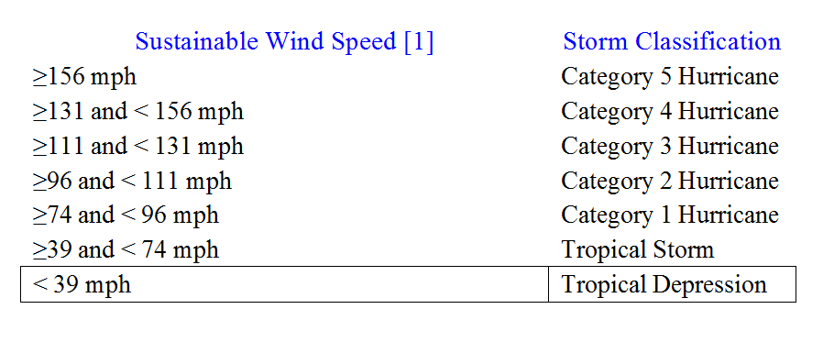
Practice 5: Storm Classification
Tropical storms are classified according to the speed of their sustainable winds as follows:
[1] Sustainable wind speed: average wind speed measured over a period of 1minute at 33 ft above the surface.
Write a class StormClassification to prompt the user for wind speed and outputs the correct category.

Slide 36
Practice 6
Let x be an int variable.
Write an if-else (or switch) statement to output “EVEN” if x is even and “ODD” if x is odd.
You may not use any variable assignments.

Slide 37
Announcements
Lab assignment 4 due Feb 6th, 9PM.
Lab 2 is graded on eLC.
Rubrics Posted for Labs 1 and 2
If you have questions about grades, please see your lab TA. You have 1 week from the time the grade is posted.
Programming project 2 due February 13th, 9PM
Test Review Guide.
Next Week: Review (Tuesday), Test 1 (Thursday)
ACM Meeting: Jordan Burke discussing Ruby on Rails!
Check your UGA email
Struggling?

